Slide 1
Data structure and Algorithm​ Lesson 6: Linked List
By Aj. Suttinee
Ref: Lecture Note CS1020 SoC NUS

Slide 2
Array VS Linked List
A[0]
A[1]
A[2]
A[3]
A[4]
Indexes
Array
34 | 8 | 64 | 51 | 32
5000
5004
5008
5012
5016
Memory locations
Linked List
34
8
64
51
32
Multiple nodes are connected by links

Slide 3
Array
Recap when using an array...
X, A, B are elements of an array
A[0]
A[1]
A[2]
A[3]
A[4]
X | A | B
I want to add Y before A ?
I want to remove A

Slide 4
Linked List
Now, we see the (add) action with linked list
X, A, B are nodes of a linked list
Y is new node to be added
X
A
B
Y
I want to add Y before A ?

Slide 5
Linked List
Now, we see the (remove) action with linked list
X, A, B are nodes of a linked list
Y is new node to be added
Node A becomes a garbage. To be removed during garbage collection.
Garbage collection is an automatic process in JVM.
I want to remove A
X
A
B

Slide 6
Linked List
Idea
Each element in the list is stored in a node, which also contains a next pointer
Allow elements in the list to occupy non-contiguous memory
Order the nodes by associating each with its neighbour(s)
element
next
element
next
element
next
. . .
X
X
X
This is one node of the collection
and this one comes after it in the collection (most likely not occupying contiguous memory that is next to the previous node)
Next pointer of this node is “null”, i.e. it has no next neighbour.

Slide 7
Array VS Linked List
Array | Linked List
An array is a collection of elements of a similar data type. | Linked List is an ordered collection of elements of the same type in which each element is connected to the next using pointers.
Array elements can be accessed randomly using the array index. | Random accessing is not possible in linked lists. The elements will have to be accessed sequentially.
Data elements are stored in contiguous locations in memory. | New elements can be stored anywhere and a reference is created for the new element using pointers.
Insertion and Deletion operations are costlier since the memory locations are consecutive and fixed. | Insertion and Deletion operations are fast and easy in a linked list.
Memory is allocated during the compile time (Static memory allocation). | Memory is allocated during the run-time (Dynamic memory allocation).
Size of the array must be specified at the time of array declaration/initialization. | Size of a Linked list grows/shrinks as and when new elements are inserted/deleted.
https://www.faceprep.in/data-structures/linked-list-vs-array/

Slide 8
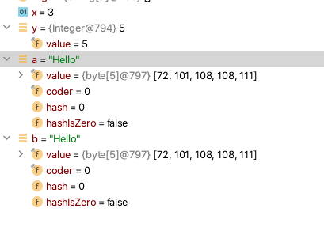
Recap: Object References
Note the difference between primitive data types and reference data types
int x = 3;
Integer y = new Integer(5);
String a = "Hello"; String b = new String("Hello");
x
3
y
5
a
H | e | l | l | o

Slide 9
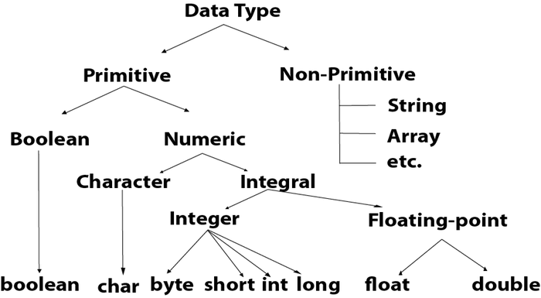
= a collection of characters
https://www.javatpoint.com/java-data-types

Slide 10
Recap: Object References
Note the difference between primitive data types and reference data types
int x = 3;
Integer y = new Integer(5);
String a = "Hello"; String b = new String("Hello");
An object of a class comes into existence (constructed) when the new operator is applied
A reference variable only contains a reference or pointer
x
3
y
5
a
H | e | l | l | o

Slide 11
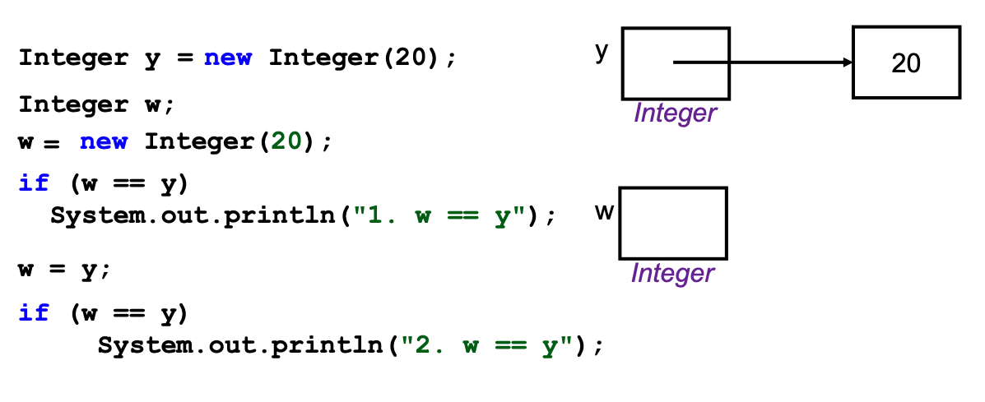
Recap: Object References
What will be the output ?

Slide 12
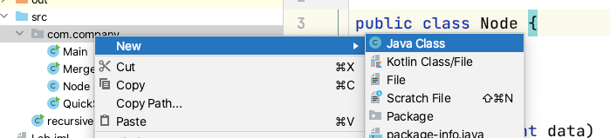
Node class
Create a new class called Node
public class Node { int element; Node next; public Node(int data) { this.element = data; } }

Slide 13
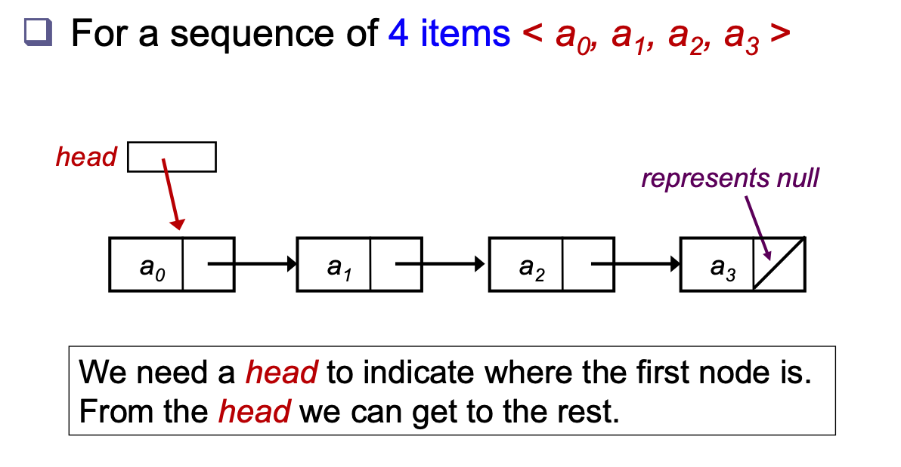
Forming a Linked List

Slide 14
Forming a Linked List
In the main method
To link node a1 and node a2
Node head = new Node(5); Node a2 = new Node(2);
element
next
element
next
head
5
a2
2
head.next = a2;
element
next
element
next
head
5
2
a2

Slide 15
Exercise
Create a linked list to store the list below.
1 5 9 10 20 8 9 7

Slide 16
Forming a Linked List
Can the code be rewritten without using these object references
Alternatively we can form the linked list as follows:
Node head = new Node(5); Node a2 = new Node(2);
Node a3 = new Node(4);
Node a4 = new Node(7);
LinkedList l = new LinkedList(5); l.addFirst(8); l.addFirst(9); l.addFirst(7);

Slide 17
Our LinkedList class
LinkedList l = new LinkedList(5);
l.addFirst(8);
l.addFirst(9);
public class LinkedList { Node head; public LinkedList(int element){ head = new Node(element); head.next = null; } public int getFirst(){ return head.element; } public void addFirst(int element){ Node temp = new Node(element); temp.next = head; head = temp; } }
head
5
X
head
5
X
temp
8

Slide 18
Our LinkedList class
LinkedList l = new LinkedList(5);
l.addFirst(8);
l.addFirst(9);
public class LinkedList { Node head; public LinkedList(int element){ head = new Node(element); head.next = null; } public int getFirst(){ return head.element; } public void addFirst(int element){ Node temp = new Node(element); temp.next = head; head = temp; } }
head
5
X
head
8
5
X
temp
temp
9

Slide 19
Remove first element
head
8
5
X
The removed node becomes a garbage. To be removed during garbage collection.

Slide 20
Exercise
In the LinkedList class
Create a method to remove the first element
Create a method to print all the elements in the linkedlist
Hint: use while loop to travel to the end of the list (next = null)
Create a method to count the number of nodes in the created linked list
Create a method to get the last element in the linkedlist

Slide 21
Tailed Linked List
public class LinkedList { Node head; Node tail; public LinkedList(int element){ head = new Node(element); head.next = null; tail = head; } public int getLast(){ return tail.element; } public void addLast(int element) { Node temp = new Node(element); tail.next = temp; tail = temp; }
…
…
We further improve on our Linked List
To address the issue that adding to the end is slow
Add an extra data member called tail
Extra data member means extra maintenance too

Slide 22
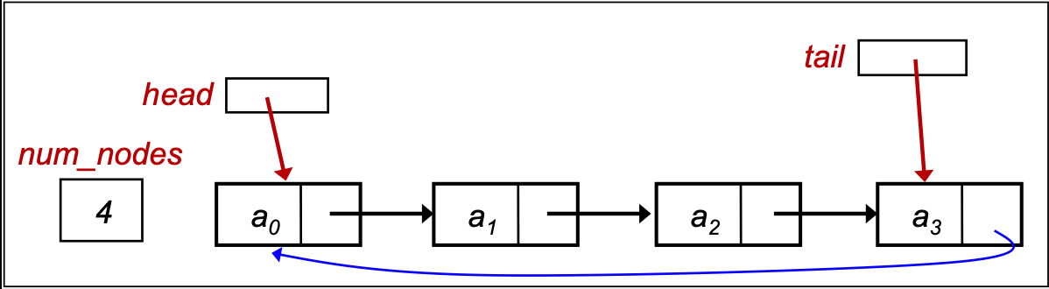
Enhancements of linked list
Circular Linked List
To allow cycling through the list repeatedly
Add a link from tail node of the Tailed Linked List to point back to head node
Different in linking need different maintenance

Slide 23
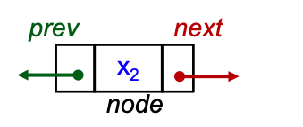
Enhancements of linked list
Doubly Linked List
In the preceding discussion, we have a “next” pointer to move forward
Often, we need to move backward as well
Use a “prev” pointer to allow backward traversal
Once again, need to maintain “prev” in all updating methods
Instead of Node class, need to create a DNode class that includes the additional “prev” pointer
public class Node { int element; Node next;
Node prev; public Node(int data) { this.element = data; } }

Slide 24
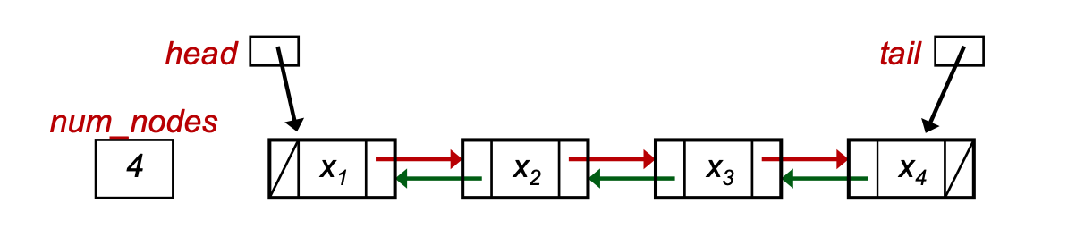
Enhancements of linked list
Doubly Linked List

Slide 25
Java Class: LinkedList
This is the class provided by Java library
It has many more methods than what we have discussed so far of our versions of linked lists.
Please do not confuse this library class from our class illustrated here. In a way, we open up the Java library to show you the inside working.

Slide 26
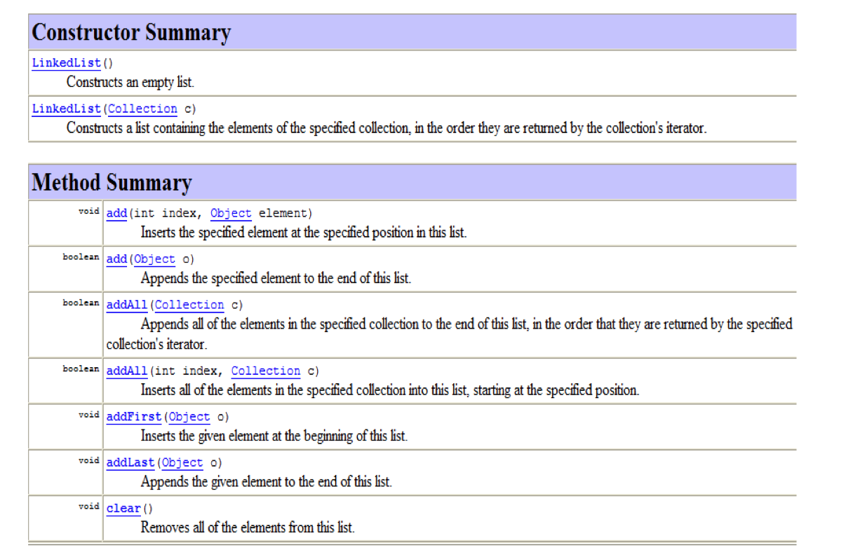
Java Class: LinkedList

Slide 27
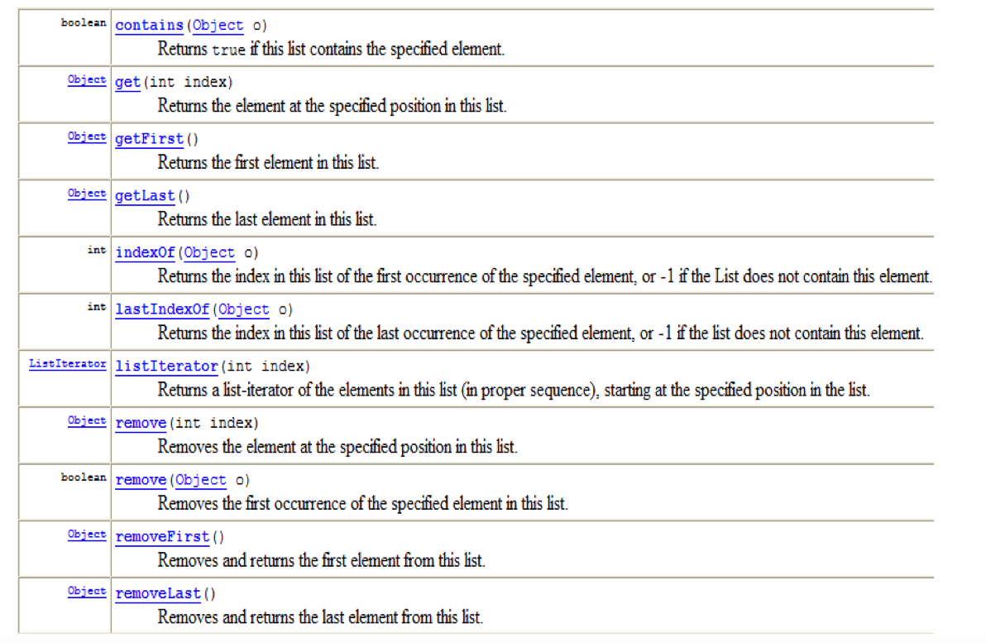
Java Class: LinkedList

Slide 28
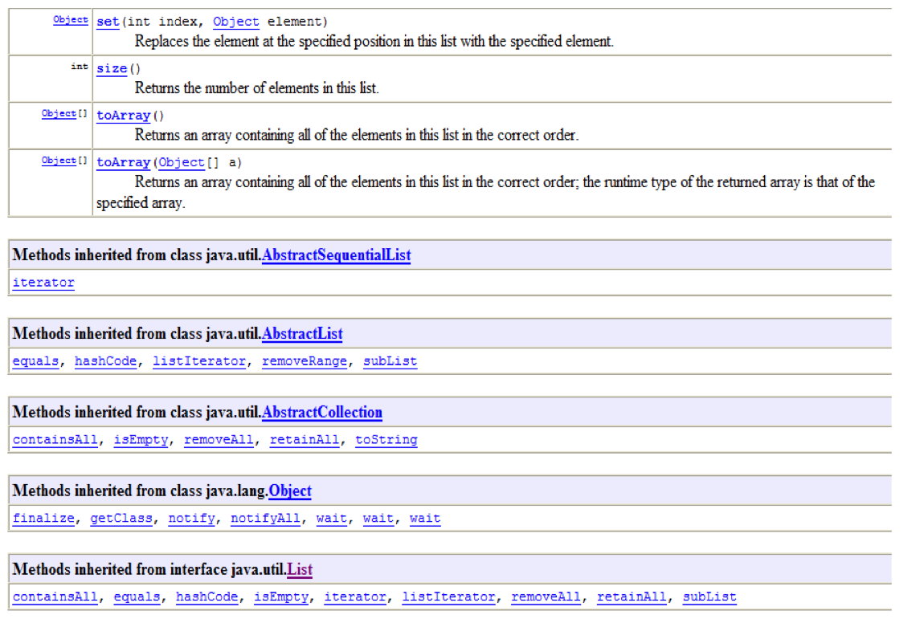
Java Class: LinkedList

Slide 29
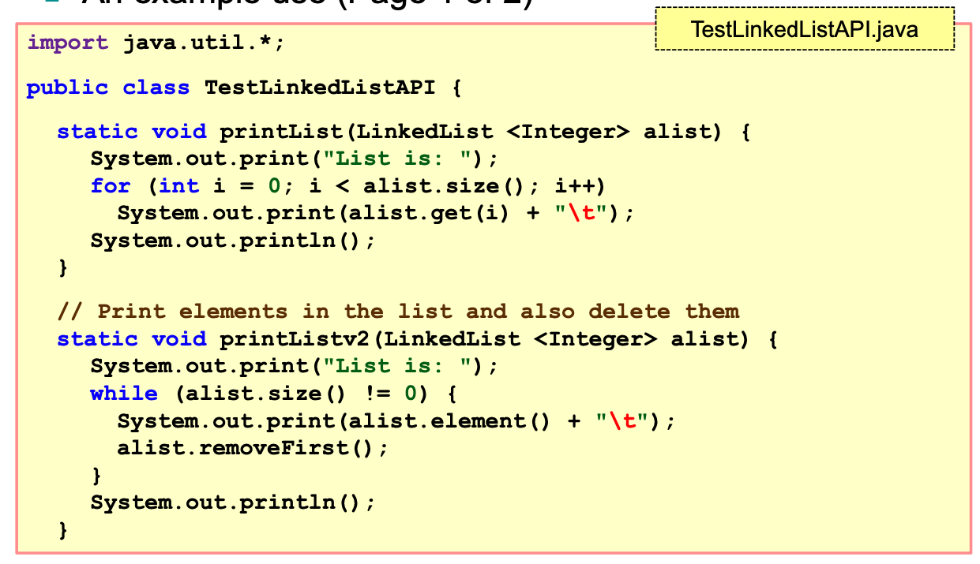
Example of use JAVA API

Slide 30
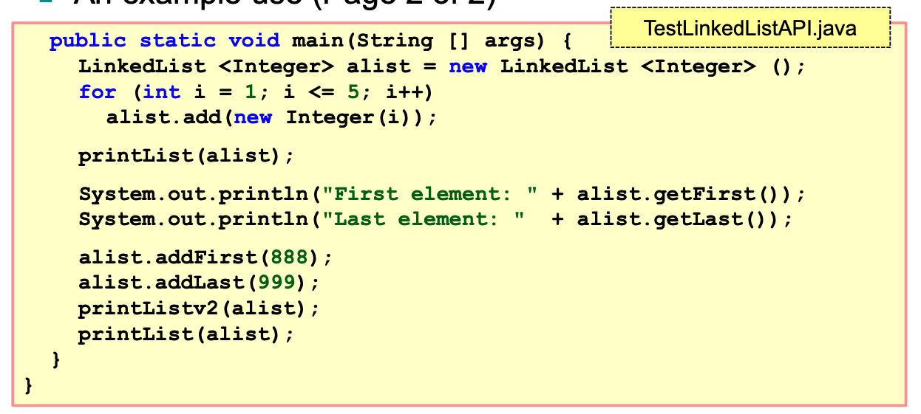
Example of use JAVA API

Slide 31
Why reinvent ?
Since there is the API, why do we need to learn to write our own code to implement a data structure like linked list?
Writing the code allows you to gain an indepth understanding of the data structures and their operations
The understanding will allow you to appreciate their complexity analysis and use the API effectively

Slide 32
Exercise
Implement a Sorted Linked List

